Slide 1

BUSINESS PLAN
ITEC101 Introduction to E-commerce
OF ZION ENGLISH
Presented by:
Bendo, Alex A.
Lim-it, Brandon B.
Punay, Jaykel O.
Recto, Marvin C.
Romasanta, Wendell Arhgel H.

Slide 2

INTRODUCTORY PAGE

Slide 3

E-LEARNING
E-LEARNING
is one of the fastest growing industry in the world. Many companies and institutions have seen the advantage of learning online, from there we have seen the rise of ESL Companies and demand for ESL Teachers. Due to the unfortunate event that happened this year, the outbreak of the virus to many countries resulted in global lockdown of education institutions. This interrupted the learning and education of students worldwide however these paved opportunities for the growth of Online Schools.

Slide 4
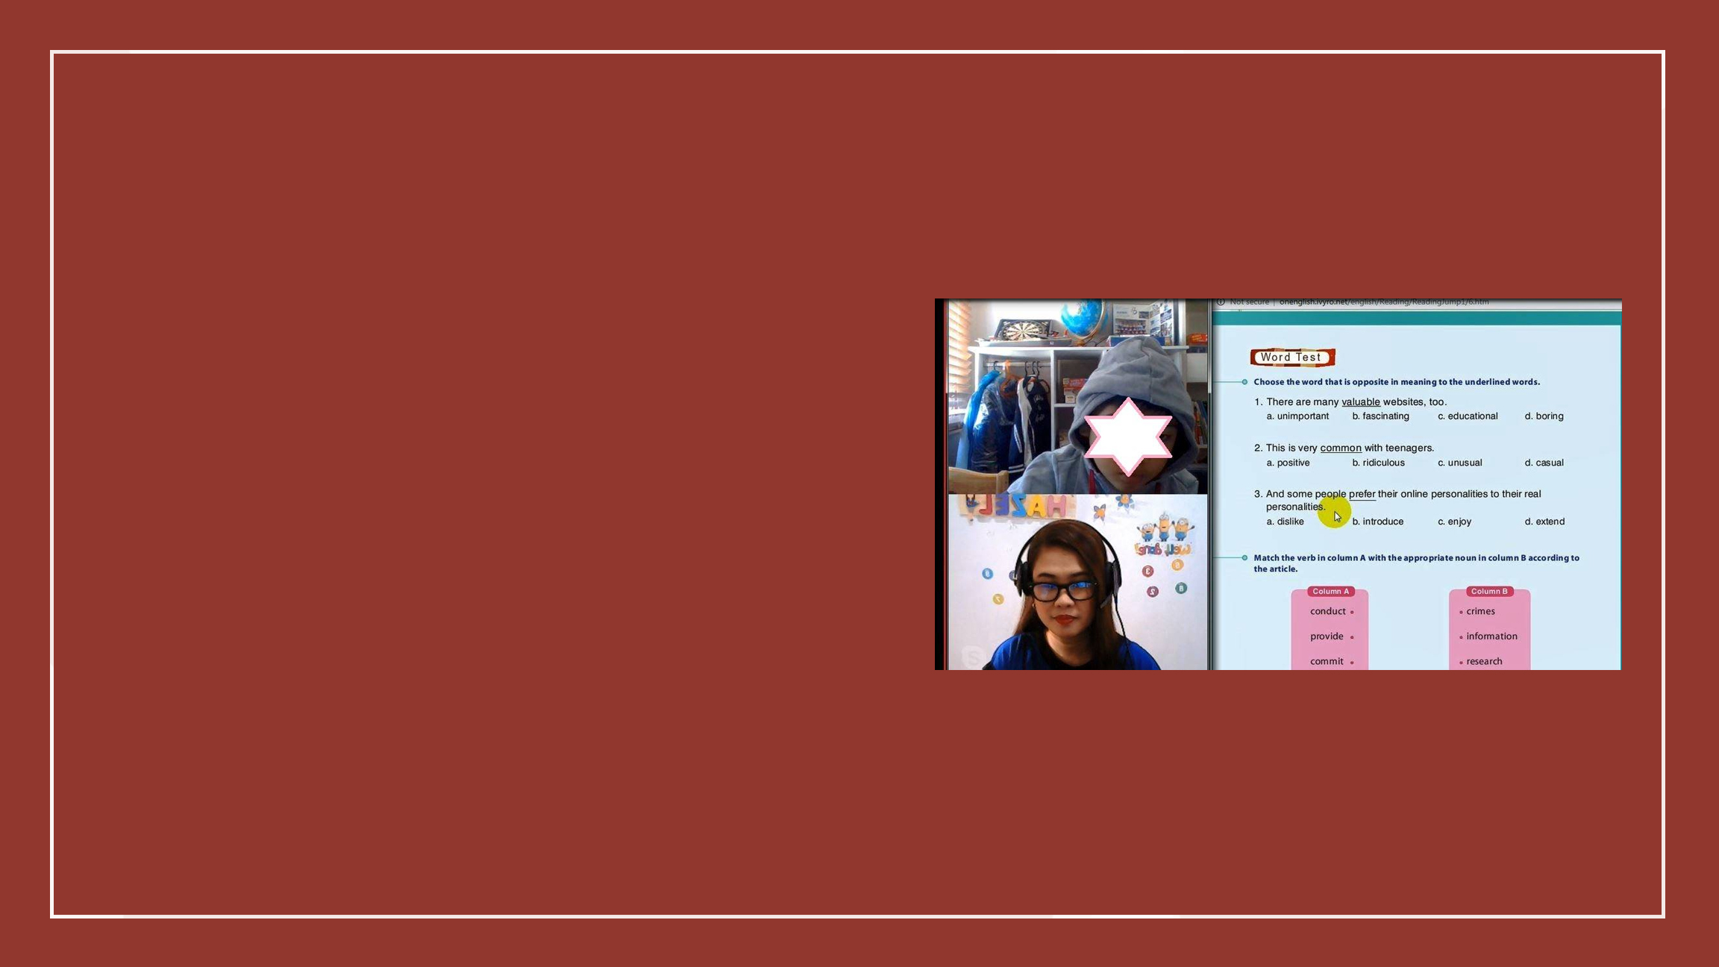
is a Filipino-based online English company that offers wide range of topics that corresponds to a student’s interest, strengths, needs and struggles in learning English as their second language mainly for Korean students. The company aims to help in breaking the language barriers for other nationalities so that they can be able to express themselves in English fluently and confidently. The company also open opportunities for Filipino teachers who are fluent and skilled to have a job or part-time job during the pandemic. Teachers of Zion English are profession ESL teachers and they have been in the industry for years. This guarantees the students that the company serves high-quality teaching. The company also offers flexible school hours that is customized according to the availability of the students and flexible working hours for teachers by working only in the comfort of their homes. Not only the company aims to teach Korean students, but it also plans to expand its platform to other countries like Japan and China.
ZION ENGLISH
ZION ENGLISH

Slide 5


Slide 6

OVERVIEW OF INDUSTRY
According to World Economic Forum, the market of E-learning was worth $166.5 billion and has been estimated to grow to $255 billion for the years to come. The cause of its enormous growth in market is because of swelling numbers of students choosing to enroll online and more online teaching schools are offering lessons and courses online. One of the fastest growing online careers is Online English Teaching because of huge demand for ESL and English language learning in Asia, specially in China. According to the consultancy firm iResearch, the market for online English lessons for China in 2016 was worth $4.5 billion dollars and that number is only growing. The major players in the industry of Online English Teaching in Asia are 51 Talk, Whales English, PalFish, iTutorGroup, Preply, Alo7 and Magic Ears.

Slide 7
TARGET MARKET
As of today, many of us chose online learning rather than face to face. Learners and home schoolers are exceedingly benefited from this mode of learning. Our target market is focused mainly for people who are willing and wanted to learn English through online school. Our services are offered for all ages from kids up to adults. Our main focus at the moment are students from Korea but we are planning to expand our market in neighboring countries like Japan and China.

Slide 8
Competition
There is a lot of online english companies that are teaching primarily for Korean students, since Zion English is focusing as if today on Korean students, one of their competitors are Nil English and Ziktalk.

Slide 9

C O M P E T I T O R S
NIL ENGLISH
is a newer online ESL company. Their company hires those with a North American accent and asks teachers commit to at least 10 hours/week. They also cater students from elementary, high school students up to adult. Nil English have their own website where you can see the services they offer as well as their rules and regulations of their school. Included in their website are their curriculum, enrollment application, payment system, tuition fee and application for teachers. They offer free trial for students who are interested in studying with them and they also offers discount and coupons for students who are referred by students who are already enrolled to them. Even though Nil English is new to the industry, they have their own mobile app on App store and Google Store. Parents and students can also reach them not only on their website but also on Instagram, Blog, Kakaotalk, Facebook and Youtube.

Slide 10

C O M P E T I T O R S
ZIKTALK
is a language sharing platform that are in live operation. There are more than 1600 registered tutors and many more students worldwide. While most of the ESL companies uses computer, Ziktalk uses mobile device. They are a language learning app that allows online English teachers to teach Korean students although they do have other nationalities. Ziktalk works off of teachers promoting their classes by uploading short educational videos. Their mission is to empower people to become fluent in foreign languages. While Nil English only hires native english speakers, Ziktalk hires also non-native english speakers. Their advantage is that they are using mobile application instead of computer or laptop which means they can easily have classes anywhere as long as they are connected online. Ziktalk have their own website also where you can see their services offered, Key features of their application, sales information, news and their contact information. Their mobile application is also available on Android and IOS plus they can also be reached through Telegram and Kakaotalk.

Slide 11
OUTLOOK AND TRENDS
The e-learning market is expected to show huge development and growth opportunities in the following five years. The rapid growth in internet connectivity in emerging economies, driven by the rising federal budgets, is likely to have a positive impact on market growth. With technological advances and virtual learning, the market for online tutoring services is expected to showcase a positive outlook during this period and in the future. Many of the universities here in the Philippines have been practicing the blended learning method to take full advantage in the online learning.

Slide 12


Slide 13

DESCRIPTION OF VENTURE
SERVICES OFFERED
• Phonetic and Alphabet
• Daily conversational topics for adult and young learners
• Job Interviews
• Reading (beginner to advance)
• English proficiency exams like IELTS - (Speaking and writing), TOIEC, TOFL and CELPIP, etc.
• Business English
• Accent/ Pronunciation Training
• Grammar
These services are all available online and can be accessed via official website zion-english.com. The business targets international clients especially countries with low English language literacy like South Korea and Japan and caters to all ages from zero beginners to adult professionals.

Slide 14


Slide 15

PRODUCTION PLAN
The source for the teaching materials is carefully selected to ensure the quality of lesson materials so that it can effective teach the student English according to their goal and level.
The employees (tutors) are locally hired but nonetheless, each one is highly trained, interpersonally skilled and graduated from some of the most competitive universities in the Philippines, to provide quality services to the clients. These tutors are to render efficient tutoring sessions.
The company guarantees that these tutors are adaptive to the needs of their students. They must also possess the energy that generates their motivation to build enthusiasm between them and the students. Also, humility and openness make a good tutor.

Slide 16


Slide 17

GOALS AND OBJECTIVE
Strategic Objective:
• To help people learn english or improve their english skills for communication
• To equip people with the ability and skill to communicate and socialize effectively using the English language
• To help Filipino teachers reach a wider audience and further improve their English teaching skills

Slide 18
PRODUCTION PROCESS
Equipments:
For Teachers
- Noise Cancelling Headphones
- Computer with atleast i3 processor and atleast with 4 GB Ram
- HD Webcam
- Internet connection with atleast 5 mbps

Slide 19
PRODUCTION PROCESS
Equipments:
Technology:
Software used in website
- Vue (for frontend and client view)
- Express (for serverless backend)
- Firebase (for authentication and database)
- Yarn (for package management)
- Git (for codebase management)

Slide 20
PRODUCTION PROCESS
Equipments:
Software used in Teaching
- Skype
- Paypal (Payment System)
- Discord/Zoom/Meet (supported alternative platforms for teaching)
- Stripe (for transactions with more features and support)

Slide 21
PRODUCTION PROCESS
Working Hours
Office Hours: 7:00 am -5:00 pm and 6:00 pm – 12:00 am
Personnel
OIC/Director – In charge in managing the teachers, class schedule and hiring new
teachers.
Data Encoder – In charge of encoding teacher’s attendance, salaries and tuition fee.
Technical Staff – In charge of managing the website and social media platforms

Slide 22
PRODUCTION PROCESS
Cost
 | Details | Allocation | Cost
1. | Zoom | Subscription Fee | 750 php (per month)
2. | Website | Domain Fee | 800 php (per month)
3. | Advertising | Facebooks Ads | 300 php (per post)
4. | Salary | For Teachers | 200 hp (per hour)

Slide 23
MARKETING STRATEGIES
CURRENT STRATEGY
Zion English is currently using Public Relations Strategy. Public Relations is created through efforts other than paid advertisements. Word-of-mouth is the main
marketing strategy that Zion English is using through the testimonials of the parents who have
their kids enrolled in the academy. Most of the students that are enrolled are usually from the close acquaintances of one of the co-owners of the company.

Slide 24

MARKETING STRATEGIES
What should be implemented:
SOCIAL MEDIA MARKETING
Since the target market of Zion English is up to all ages, this is the best kind of strategy that should be used to attract more potential students for the company. According to the SBS News, 95% of the population in South Korea owns a smart phone and according also to Statista, South Korea had the third highest rate of active social media users which means almost all Koreans can be reached through social media with just the right platform to use. Zion English should have BAND and Kakaotalk beacuse most of the Koreans are using these applications, it should be effective in reaching more people. The website should be also searchable through Naver, it’s a search engine that is mainly used in South Korea and it became their default browser as the start page.

Slide 25

MARKETING STRATEGIES
What should be implemented:
REFERRAL PROGRAMS
It is the method of promoting
products or services to new customers through referrals, usually word of mouth. Such referrals often happen spontaneously but businesses can influence this through appropriate strategies. This kind of strategy is well known in this kind of business because it can quickly encourage people to purchase the service in exchange of something like discount on their end or other rewards from the company. It can be done online or through word-of-mouth, referral marketing can potentially
increase brand awareness, referrals and, ultimately, revenue.

